Slide 1
Algorithm Design & Problem Solving: Algorithm Analysis

Slide 2
Contents
1
Observation
2
Models
3
Order of Growth
4
Theory of Algorithms

Slide 3

The challenge
Q. Will my program be able to solve a large practical input?
Insight. [Knuth 1970s] Use scientific method to understand performance.
Why does it run out of memory ?
Why is my program so slow ?

Slide 4

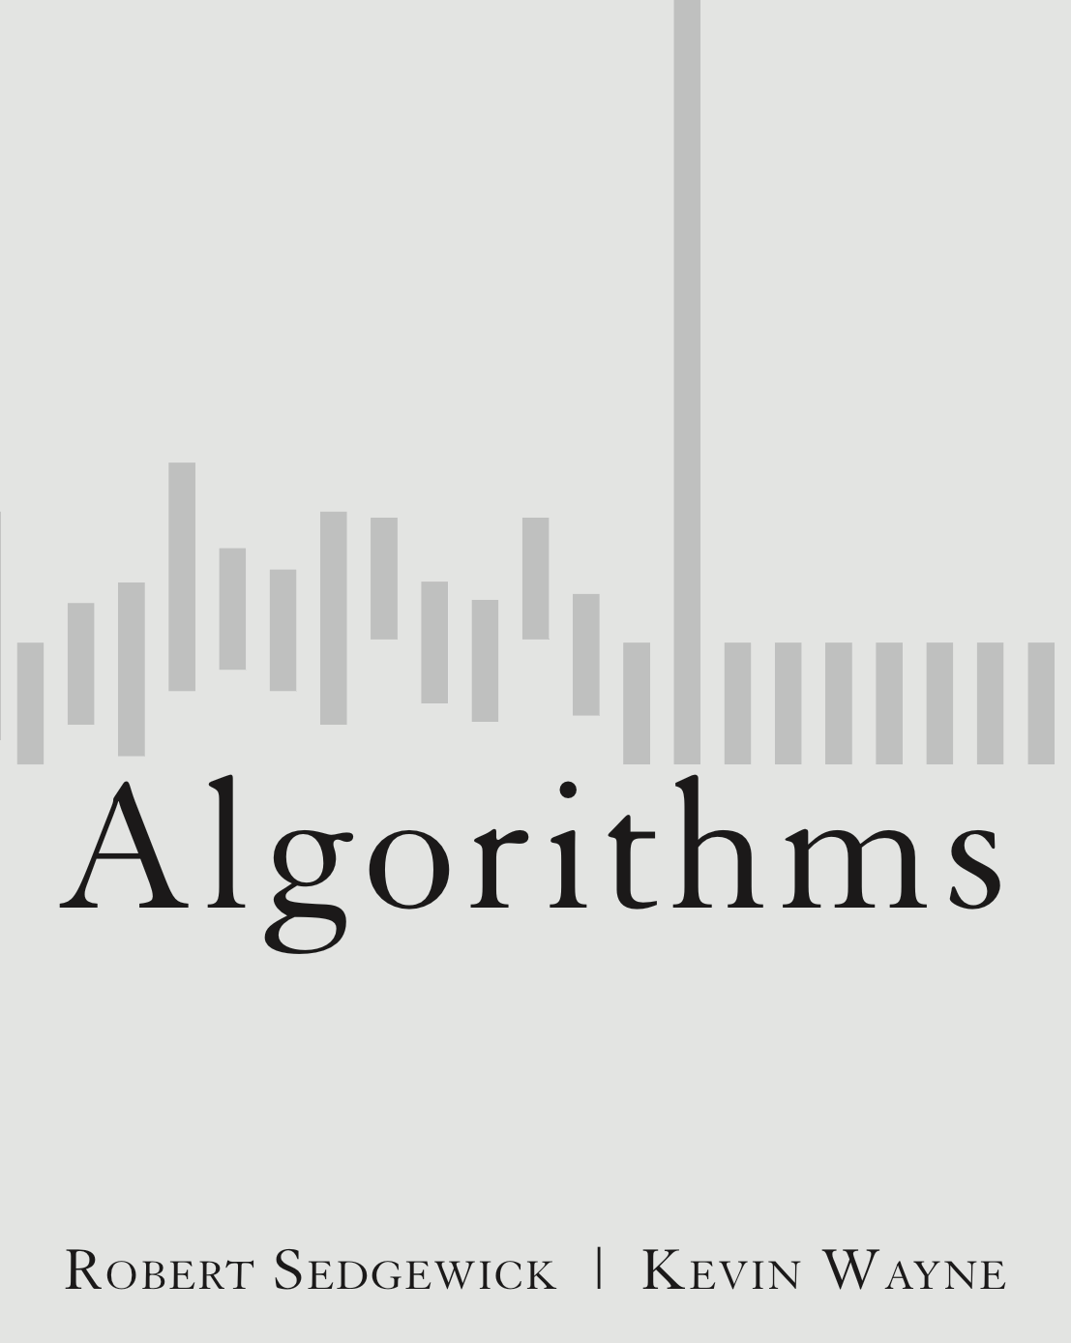
1.4 Analysis of Algorithms
introduction
observations
mathematical models
order-of-growth classifications
theory of algorithms
memory
http://algs4.cs.princeton.edu

Slide 5

Scientific method applied to analysis of algorithms
A framework for predicting performance and comparing algorithms.
Scientific method.
Observe some feature of the natural world.
Hypothesize a model that is consistent with the observations.
Predict events using the hypothesis.
Verify the predictions by making further observations.
Validate by repeating until the hypothesis and observations agree.
Principles.
Experiments must be reproducible.
Hypotheses must be falsifiable.
Feature of the natural world. Computer itself.

Slide 6

Example: 3-Sum
3-Sum. Given N distinct integers, how many triples sum to exactly zero?
Context. Deeply related to problems in computational geometry.
% more 8ints.txt
8
30 -40 -20 -10 40 0 10 5
% java ThreeSum 8ints.txt
4
1
2
3
4
a[i] | a[j] | a[k] | sum
30 | -40 | 10 | 0
30 | -20 | -10 | 0
-40 | 40 | 0 | 0
-10 | 0 | 10 | 0
Notes:
distinctness of integers not crucial to problem (but simplifies code for N^2 log N algorithm discussed later)

Slide 7
3-Sum: brute-force algorithm
int find3NumbersforSum(int A[], int arr_size, int sum)
{
int i,j,k count=0;
for ( i = 0; i < arr_size - 2; i++) {
for (j = i + 1; j < arr_size - 1; j++) {
for (k = j + 1; k < arr_size; k++)
if (A[i] + A[j] + A[k] == sum) count++;
}
}
return count;
}
check each triple
for simplicity, ignore integer overflow
Notes:
this method counts the number of triples (i < j < k to avoid double counting)

Slide 8
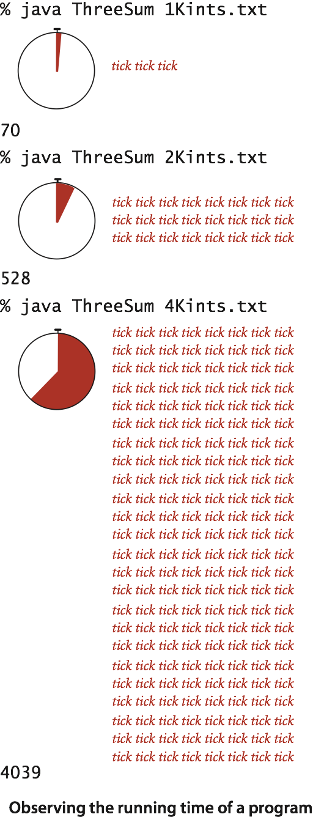
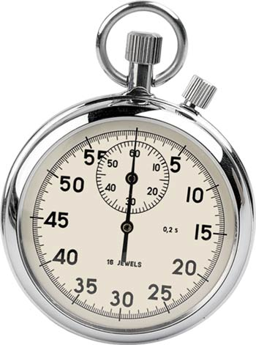
Measuring the running time
Q. How to time a program?
A. Manual.

Slide 9
Empirical analysis
Run the program for various input sizes and measure running time.
N | time (seconds) †
250 | 0
500 | 0
1,000 | 0.1
2,000 | 0.8
4,000 | 6.4
8,000 | 51.1
16,000 | ?
Notes:
These timings are on a faster computer.

Slide 10
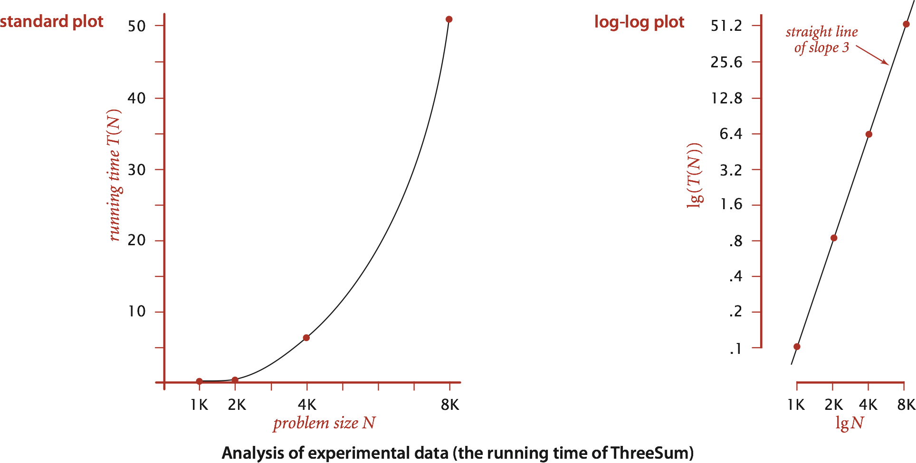
Data analysis
Standard plot. Plot running time T (N) vs. input size N.

Slide 11
Data analysis
Log-log plot. Plot running time T (N) vs. input size N using log-log scale.
Regression. Fit straight line through data points: a N ^{b}.
Hypothesis. The running time is about 1.006 × 10 ^{–10} × N ^{2.999} seconds.
eqn of straight line :-y=bx+c
lg(T (N)) = b lg N + c
b = 2.999
c = -33.2103
T (N) = a N ^{b}, where a = 2 ^{c}
3 orders
of magnitude
power law
slope
Notes:
log-log plot identifies power law relationships
technically, we shouldn't really run a linear regression on log-log scale - it's not statistically valid.

Slide 12
Prediction and validation
Hypothesis. The running time is about 1.006 × 10 ^{–10} × N ^{2.999} seconds.
Predictions.
51.0 seconds for N = 8,000.
408.1 seconds for N = 16,000.
Observations.
"order of growth" of running time is about N³ [stay tuned]
N | time (seconds) †
8,000 | 51.1
8,000 | 51
8,000 | 51.1
16,000 | 410.8
validates hypothesis!
Notes:
lg(T(N)) = 2.9992 lg N - 33.2103, correlation coefficient = 1.0
Very accurate predictions.
2x input size -> 8x increase in running time for cubic algorithm

Slide 13
Experimental algorithmics
System independent effects.
Algorithm.
Input data.
System dependent effects.
Hardware: CPU, memory, cache, …
Software: compiler, interpreter, garbage collector, …
System: operating system, network, other apps, …
Bad news. Difficult to get precise measurements. Good news. Much easier and cheaper than other sciences.
determines exponent
in power law
determines constant in power law
e.g., can run huge number of experiments
Notes:
CPU use by other applications: if connected to Internet, some hacker is using your computer to send spam, steal your money, etc.
Good news: compared to other scientists, running computational experiments is easy. Don't need to kill cows, blow up islands.

Slide 14
1.4 Analysis of Algorithms
introduction
observations
mathematical models
order-of-growth classifications
theory of algorithms
memory
http://algs4.cs.princeton.edu

Slide 15
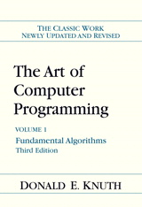
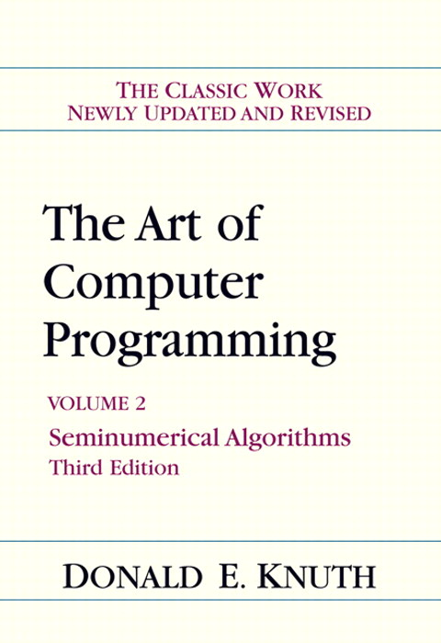
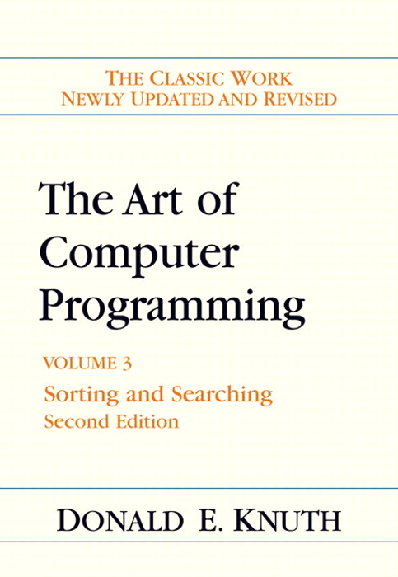
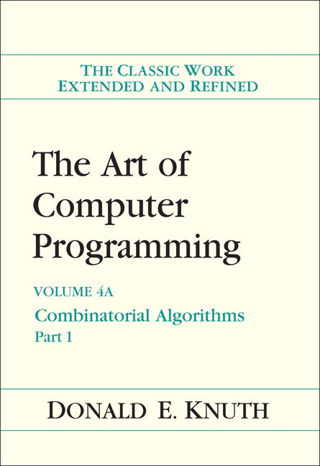
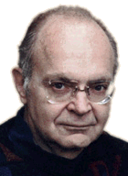
Mathematical models for running time
Total running time: sum of cost × frequency for all operations.
Need to analyze program to determine set of operations.
Cost depends on machine, compiler.
Frequency depends on algorithm, input data.
In principle, accurate mathematical models are available.
Donald Knuth 1974 Turing Award
Notes:
most famous modeling by Knuth - detailed results to accurate predict running time
Knuth's idea seems obvious in hindsight, but in the 1960s, programmers said it would never be possible to analyze the running time of a computer program since they are too complicated. Knuth's TAOCP is now a classic treatise on the subject.

Slide 16
Cost of basic operations
Challenge. How to estimate constants.
operation | example | nanoseconds †
integer add | a + b | 2.1
integer multiply | a * b | 2.4
integer divide | a / b | 5.4
floating-point add | a + b | 4.6
floating-point multiply | a * b | 4.2
floating-point divide | a / b | 13.5
sine | Math.sin(theta) | 91.3
arctangent | Math.atan2(y, x) | 129
... | ... | ...
† Running OS X on Macbook Pro 2.2GHz with 2GB RAM
Notes:
trig and exponential ops more expensive that integer ops

Slide 17
Example: 1-Sum
Q. How many instructions as a function of input size N ?
int i,count = 0;
for ( i = 0; i < N; i++) {
if (a[i] == 0)
count++;
N array accesses
operation | frequency
variable declaration | 2
assignment statement | 2
less than compare | N + 1
equal to compare | N
array access | N
Increment ( i++ plus count++ ) | N to 2 N
Notes:
that's the cost of each operation; more interestingly is the frequency of each operation
walk through frequency count for array accesses
consider putting in instruction counts for N = 10000
increment: between N (no zeros) and 2N (all zeros)

Slide 18
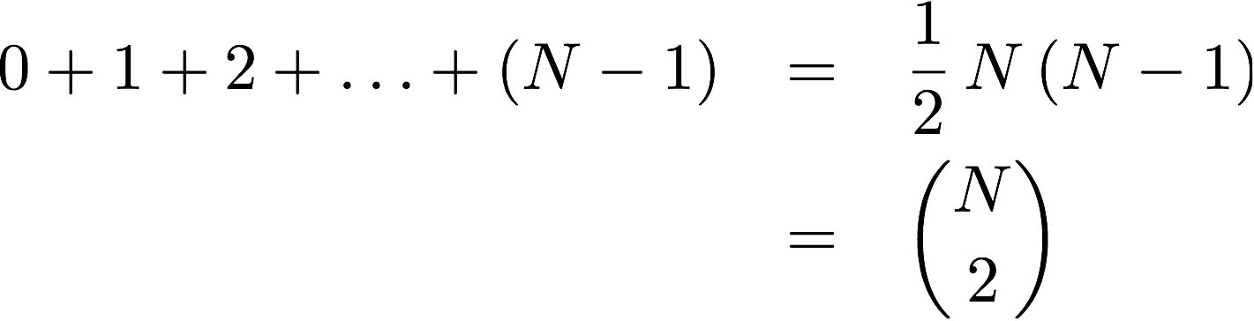
Example: 2-Sum
Q. How many instructions as a function of input size N ?
int i,j,count = 0;
for (i = 0; i < N; i++) {
for ( j = i+1; j < N; j++) {
if (a[i] + a[j] == 0)
count++;
operation | frequency
variable declaration | N + 2
assignment statement | N + 2
less than compare | ½ (N + 1) (N + 2)
equal to compare | ½ N (N − 1)
array access | N (N − 1)
increment | ½ N (N − 1) to N (N − 1)
tedious to count exactly
Notes:
N choose 2 – the number of ways to pick any 2 numbers from the input array
N(N-1) instead of ½ N(N-1) because there are two array accesss per inner loop

Slide 19
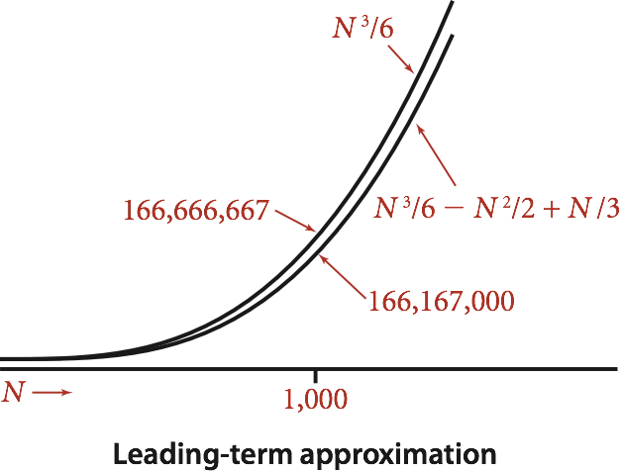
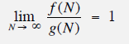
Simplification 2: tilde notation
Estimate running time (or memory) as a function of input size N.
Ignore lower order terms.
when N is large, terms are negligible
when N is small, we don't care
Ex 1. ⅙ N ³ + 20 N + 16 ~ ⅙ N ³
Ex 2. ⅙ N ³ + 100 N ^{4/3} + 56 ~ ⅙ N ³
Ex 3. ⅙ N ³ − ½ N ² + ⅓ N ~ ⅙ N ³
Technical definition. f(N) ~ g(N) means
discard lower-order terms (e.g., N = 1000: 166.67 million vs. 166.17 million)
Notes:
lower order term is 500,000

Slide 20
Simplification 2: tilde notation
Estimate running time (or memory) as a function of input size N.
Ignore lower order terms.
when N is large, terms are negligible
when N is small, we don't care
operation | frequency | tilde notation
variable declaration | N + 2 | ~ N
assignment statement | N + 2 | ~ N
less than compare | ½ (N + 1) (N + 2) | ~ ½ N ²
equal to compare | ½ N (N − 1) | ~ ½ N ²
array access | N (N − 1) | ~ N ²
increment | ½ N (N − 1) to N (N − 1) | ~ ½ N ² to ~ N ²

Slide 21
Example: 2-Sum
Q. Approximately how many array accesses as a function of input size N ?
A. ~ N ² array accesses.
Bottom line. Use cost model and tilde notation to simplify counts.
int i,j,count = 0;
for (i = 0; i < N; i++)
for (j = i+1; j < N; j++)
if (a[i] + a[j] == 0)
count++;
"inner loop"

Slide 22
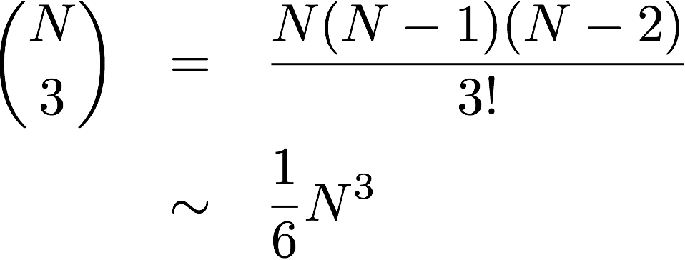
Example: 3-Sum
Q. Approximately how many array accesses as a function of input size N ?
A. ~ ½ N ³ array accesses.
Bottom line. Use cost model and tilde notation to simplify counts.
int i,j,k,count = 0;
for ( i = 0; i < N; i++) {
for ( j = i+1; j < N; j++) {
for ( k = j+1; k < N; k++) {
if (a[i] + a[j] + a[k] == 0)
count++;
"inner loop"
Notes:
N^3 / 6 arises because N choose 3 is the number of triples i, j, k
½ N^3 because there are three array accesses in the inner loop

Slide 23
3-Sum Approximate Running Time
Q. How long will it take to run?
Only count instructions that execute most frequently – the inner loop (D)
So, including all the variable init and add ops
Total Time T(N) := (T₁ * A) + (T₂ * B) + (T₃ * C) + (T₄ * D) +(x * E)
Note that E is execution dependent – how many of N’s add up to 0
int i,j,k,count = 0;
for ( i = 0; i < N; i++) {
for ( j = i+1; j < N; j++) {
for ( k = j+1; k < N; k++) {
if (a[i] + a[j] + a[k] == 0)
count++;
A 1
B N
C ~N²/2
D ~n³/6
"inner loop"
E input dependent
Notes:
N^3 / 6 arises because N choose 3 is the number of triples i, j, k
½ N^3 because there are three array accesses in the inner loop

Slide 24
Order of Growth
T(n) of 3sum function is ~N³/6
Order of Growth of function is N³
Note that this reflects what we saw with the power law aN³ where a is some machine dependent factor

Slide 25
1.4 Analysis of Algorithms
introduction
observations
mathematical models
order-of-growth classifications
theory of algorithms
memory
http://algs4.cs.princeton.edu

Slide 26
Common order-of-growth classifications
Definition. If f (N) ~ c g(N) for some constant c > 0, then the order of growth of f (N) is g(N).
Ignores leading coefficient.
Ignores lower-order terms.
Ex. The order of growth of the running time of this code is N ³.
Typical usage. With running times.
int i,j,k,count = 0;
for (i = 0; i < N; i++) {
for (j = i+1; j < N; j++) {
for (k = j+1; k < N; k++) {
if (a[i] + a[j] + a[k] == 0)
count++;
where leading coefficient
depends on machine, compiler, JVM, ...

Slide 27
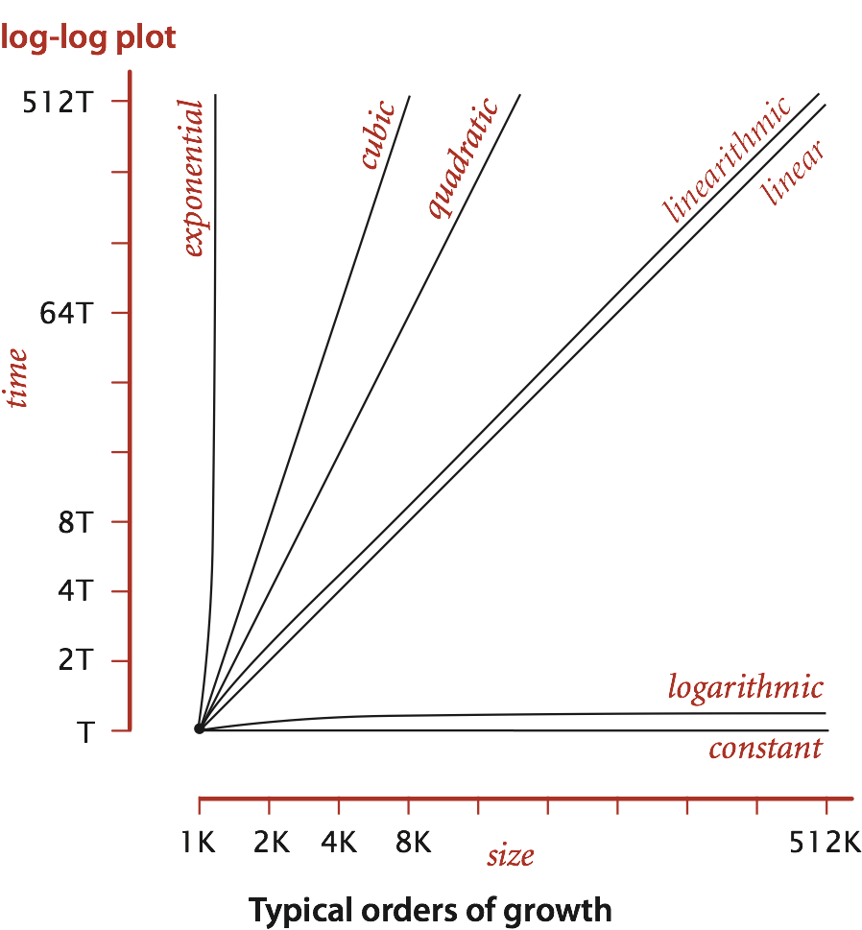
Common order-of-growth classifications
Good news. The set of functions 1, log N, N, N log N, N ², N ³, and 2^{N}
suffices to describe the order of growth of most common algorithms.
Notes:
reason: programs are comprised of just a few structural primitives: statements, loops, conditionals, nesting, function calls

Slide 28
Common order-of-growth classifications
order of growth | name | typical code framework | description | example | T(2N) / T(N)
1 | constant | a = b + c; | statement | add two numbers | 1
log N | logarithmic | while (N > 1) { N = N / 2; ... } | divide in half | binary search | ~ 1
N | linear | for (int i = 0; i < N; i++) { ... } | loop | find the maximum | 2
N log N | linearithmic | [see mergesort lecture] | divide and conquer | mergesort | ~ 2
N ² | quadratic | for (int i = 0; i < N; i++) for (int j = 0; j < N; j++) { ... } | double loop | check all pairs | 4
N ³ | cubic | for (int i = 0; i < N; i++) for (int j = 0; j < N; j++) for (int k = 0; k < N; k++) { ... } | triple loop | check all triples | 8
2^{N} | exponential | [see combinatorial search lecture] | exhaustive search | check all subsets | T(N)
Notes:
this partially explains reason why small set of functions
arises from straightforward composition of loops, conditionals, functions
T(2N) / T(N) is factor for doubling hypothesis

Slide 29
Practical implications of order-of-growth
growth rate | problem size solvable in minutes
 | 1970s | 1980s | 1990s | 2000s
1 | any | any | any | any
log N | any | any | any | any
N | millions | tens of millions | hundreds of millions | billions
N log N | hundreds of thousands | millions | millions | hundreds of millions
N² | hundreds | thousand | thousands | tens of thousands
N³ | hundred | hundreds | thousand | thousands
2^{N} | 20 | 20s | 20s | 30

Slide 30
Practical implications of order-of-growth
growth rate | problem size solvable in minutes |  |  |  | time to process millions of inputs
 | 1970s | 1980s | 1990s | 2000s | 1970s | 1980s | 1990s | 2000s
1 | any | any | any | any | instant | instant | instant | instant
log N | any | any | any | any | instant | instant | instant | instant
N | millions | tens of millions | hundreds of millions | billions | minutes | seconds | second | instant
N log N | hundreds of thousands | millions | millions | hundreds of millions | hour | minutes | tens of seconds | seconds
N² | hundreds | thousand | thousands | tens of thousands | decades | years | months | weeks
N³ | hundred | hundreds | thousand | thousands | never | never | never | millennia
30

Slide 31
Practical implications of order-of-growth
growth rate | name | description | effect on a program that runs for a few seconds
 |  |  | time for 100x more data | size for 100x faster computer
1 | constant | independent of input size | – | –
log N | logarithmic | nearly independent of input size | – | –
N | linear | optimal for N inputs | a few minutes | 100x
N log N | linearithmic | nearly optimal for N inputs | a few minutes | 100x
N² | quadratic | not practical for large problems | several hours | 10x
N³ | cubic | not practical for medium problems | several weeks | 4–5x
2^{N} | exponential | useful only for tiny problems | forever | 1x
31

Slide 32
1.4 Analysis of Algorithms
introduction
observations
mathematical models
order-of-growth classifications
theory of algorithms
memory
http://algs4.cs.princeton.edu

Slide 33
Types of analyses
Best case. Lower bound on cost.
Determined by “easiest” input.
Provides a goal for all inputs.
Worst case. Upper bound on cost.
Determined by “most difficult” input.
Provides a guarantee for all inputs.
Average case. Expected cost for random input.
Need a model for “random” input.
Provides a way to predict performance.
this course
Ex 1. Array accesses for brute-force 3-Sum. Best: ∼ ½ N ³
Average: ∼ ½ N ³
Worst: ∼ ½ N ³
Ex 2. Compares for binary search.
Best: ∼ 1
Average: ∼ lg N
Worst: ∼ lg N

Slide 34
Types of analyses
Best case. Lower bound on cost.
Worst case. Upper bound on cost.
Average case. “Expected” cost.
Actual data might not match input model?
Need to understand input to effectively process it.
Approach 1: design for the worst case.
Approach 2: randomize, depend on probabilistic guarantee.

Slide 35
Theory of algorithms
Goals.
Establish “difficulty” of a problem.
Develop “optimal” algorithms.
Approach.
Suppress details in analysis: analyze “to within a constant factor.”
Eliminate variability in input model: focus on the worst case.
Upper bound. Performance guarantee of algorithm for any input.
Lower bound. Proof that no algorithm can do better.
Optimal algorithm. Lower bound = upper bound (to within a constant factor).

Slide 36
Commonly-used notations in the theory of algorithms
notation | provides | example | shorthand for | used to
Big Theta | asymptotic order of growth | Θ(N²) | ½ N ² 10 N ² 5 N ² + 22 N log N + 3N ⋮ | classify algorithms
Big Oh | Θ(N²) and smaller | O(N²) | 10 N ² 100 N 22 N log N + 3 N ⋮ | develop upper bounds
Big Omega | Θ(N²) and larger | Ω(N²) | ½ N ² N ⁵ N ³ + 22 N log N + 3 N ⋮ | develop lower bounds

Slide 37
Theory of algorithms: example 1
Goals.
Establish “difficulty” of a problem and develop “optimal” algorithms.
Ex. 1-Sum = “Is there a 0 in the array? ”
Upper bound. A specific algorithm.
Ex. Brute-force algorithm for 1-Sum: Look at every array entry.
Running time of the optimal algorithm for 1-Sum is O(N).
Lower bound. Proof that no algorithm can do better.
Ex. Have to examine all N entries (any unexamined one might be 0).
Running time of the optimal algorithm for 1-Sum is Ω(N).
Optimal algorithm.
Lower bound equals upper bound (to within a constant factor).
Ex. Brute-force algorithm for 1-Sum is optimal: its running time is Θ(N).

Slide 38
Theory of algorithms: example 2
Goals.
Establish “difficulty” of a problem and develop “optimal” algorithms.
Ex. 3-Sum.
Upper bound. A specific algorithm.
Ex. Brute-force algorithm for 3-Sum.
Running time of the optimal algorithm for 3-Sum is O(N ³).

Slide 39
Theory of algorithms: example 2
Goals.
Establish “difficulty” of a problem and develop “optimal” algorithms.
Ex. 3-Sum.
Upper bound. A specific algorithm.
Ex. Improved algorithm for 3-Sum.
Running time of the optimal algorithm for 3-Sum is O(N ² log N ).
Lower bound. Proof that no algorithm can do better.
Ex. Have to examine all N entries to solve 3-Sum.
Running time of the optimal algorithm for solving 3-Sum is Ω(N ).
Open problems.
Optimal algorithm for 3-Sum?
Subquadratic algorithm for 3-Sum?
Quadratic lower bound for 3-Sum?

Slide 40
Algorithm design approach
Start.
Develop an algorithm.
Prove a lower bound.
Gap?
Lower the upper bound (discover a new algorithm).
Raise the lower bound (more difficult).
Golden Age of Algorithm Design.
1970s‑.
Steadily decreasing upper bounds for many important problems.
Many known optimal algorithms.
Caveats.
Overly pessimistic to focus on worst case?
Need better than “to within a constant factor” to predict performance.

Slide 41
Commonly-used notations in the theory of algorithms
notation | provides | example | shorthand for | used to
Tilde | leading term | ~ 10 N ² | 10 N ² 10 N ² + 22 N log N 10 N ² + 2 N + 37 | provide approximate model
Big Theta | Asymptotic order of growth | Θ(N²) | ½ N ² 10 N ² 5 N ² + 22 N log N + 3N | classify algorithms
Big Oh | Θ(N²) and smaller | O(N²) | 10 N ² 100 N 22 N log N + 3 N | develop upper bounds
Big Omega | Θ(N²) and larger | Ω(N²) | ½ N ² N ⁵ N ³ + 22 N log N + 3 N | develop lower bounds

Slide 42
big-Oh notation
Big Oh/Big O
Worst Case performance
Big Oh is not going to show exact timing of algorithm
Just how long it takes to run with its worst case data set in terms of the number of items (N) being processed

Slide 43
Big-O Notation Test yourself!
What is the worst-case complexity of the each of the following code fragments?
for (i = 0; i < N; i++)
…sequence of statements
for (j = 0; j < M; j++) {
…sequence of statements }
How would the complexity change if the second loop went to N instead of M?
1
for (i = 0; i < N; i++) {
for (j = 0; j < N; j++) {
…sequence of statements
}
}
for (k = 0; k < N; k++) {
…sequence of statements
}
2

Slide 44
Give the order of growth (as a function of N) of the running times of each of the following code fragments:
int sum = 0;
for (int k = N; k > 0; k = k/2)
for (int i = 0; i < k; i++)
sum++;
int sum = 0;
for (int i = 1; i < N; i = i* 2)
for(int j = 0; j < i; j++)
sum++;
int sum = 0;
for (int i = 1; i < N; i *= 2)
for (int j = 0; j < N; j++)
sum++;

Slide 45
Give the order of growth (as a function of N) of the running times of each of the following code fragments:
1
3
void function(int n)
{
if (n==1)
return;
for (int i=1; i<=n; i++) {
for (int j=1; j<=n; j++){
putchar(‘*’);
break;
}
}
}
void function(int n)
{
int count = 0;
for (int i=n/2; i<=n; i++)
for (int j=1;j+n/2<=n; j=j++)
for (int k=1;k<=n;k=k*2)
count++;
}
4
2
void function(int n)
{
int count = 0;
for (int i=n/2; i<=n; i++)
for (int j=1; j<=n; j=2 * j)
for (int k=1;k<=n;k=k * 2)
count++;
}
void function(int n)
{
int count = 0;
for (int i=0; i<n; i++)
for (int j=i; j< i*i; j++)
if (j%i == 0){
for (int k=0; k<j; k++)
printf("*");
}
}
Notes:
O(n) – look at the break
O(n log^2(n)) – n/2 * logn * logn
O(n^2Log(n)) – n/2* n/2 * logn
N*(n^2)*(n/2*n) = O(N^5)

Slide 46
Thank You !

